Slide 1
NAME : P VAANATHI
REG. NO. : 513121104046
COLLEGE NAME : THANTHAI PERIYAR GOVERNMENT INSTITUTE OF TECHNOLOGY VELLORE
DEPARTMENT : COMPUTER SCIENCE AND ENGINEERING
YEAR : THIRD YEAR
NM ID. : au513121104046
SKILL BUILD ID : vaanathipoovannan2108@gmail.com
PROJECT TITLE : STOCK PRICE PREDICTION USING LSTM NEURAL NETWORK

Slide 2

STOCK PRICE PREDICTION USING LSTM NEURAL NETWORK

Slide 3
AGENDA
PROBLEM STATEMENT
OVERVIEW
THE END USER
SOLUTION AND VALUE PROPOSITION
Building the LSTM Model
Model Compilation and Training
Making Predictions
Visualization
WOW OF THE SOLUTION
Advanced Technology
Data Transformation
Model Architecture
Prediction Accuracy
Real-world Application
MODELLING
RESULT

Slide 4
PROBLEM STATEMENT
Develop a predictive model to forecast future stock prices of a given company, Apple Inc., based on historical stock price data. The task involves constructing a Long Short-Term Memory (LSTM) neural network model using the Keras library. The model should be trained on a training dataset consisting of past stock prices and evaluated on a separate testing dataset. The goal is to accurately predict future stock prices using sequential historical data, thereby assisting investors and financial analysts in making informed decisions

Slide 5
OVERVIEW:
IMPORTING DATA
PREPROCESSING
TRAINING
PREDICTING STOCK PRICE
VISUALISING
BUILDING LSTM MODEL
VISUALISING
Implements a recurrent neural network (RNN), specifically a Long Short-Term Memory (LSTM) network, for predicting Apple stock prices.
It begins by importing and visualizing the data, preprocesses it for model training, builds the LSTM model with multiple layers, trains the model on the training data, and then predicts stock prices for the test dataset.
Finally, it visualizes the predicted prices alongside the actual prices for evaluation.
Overall, Project showcasing the use of deep learning for stock price prediction.

Slide 6
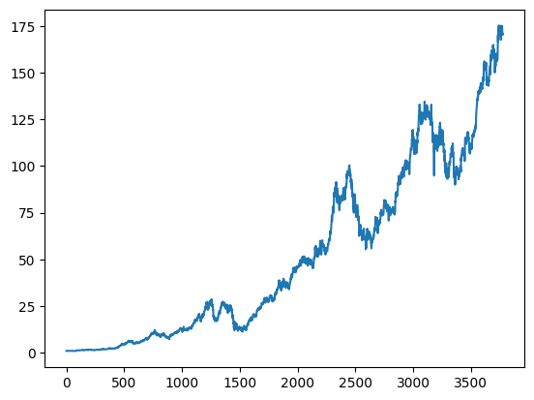
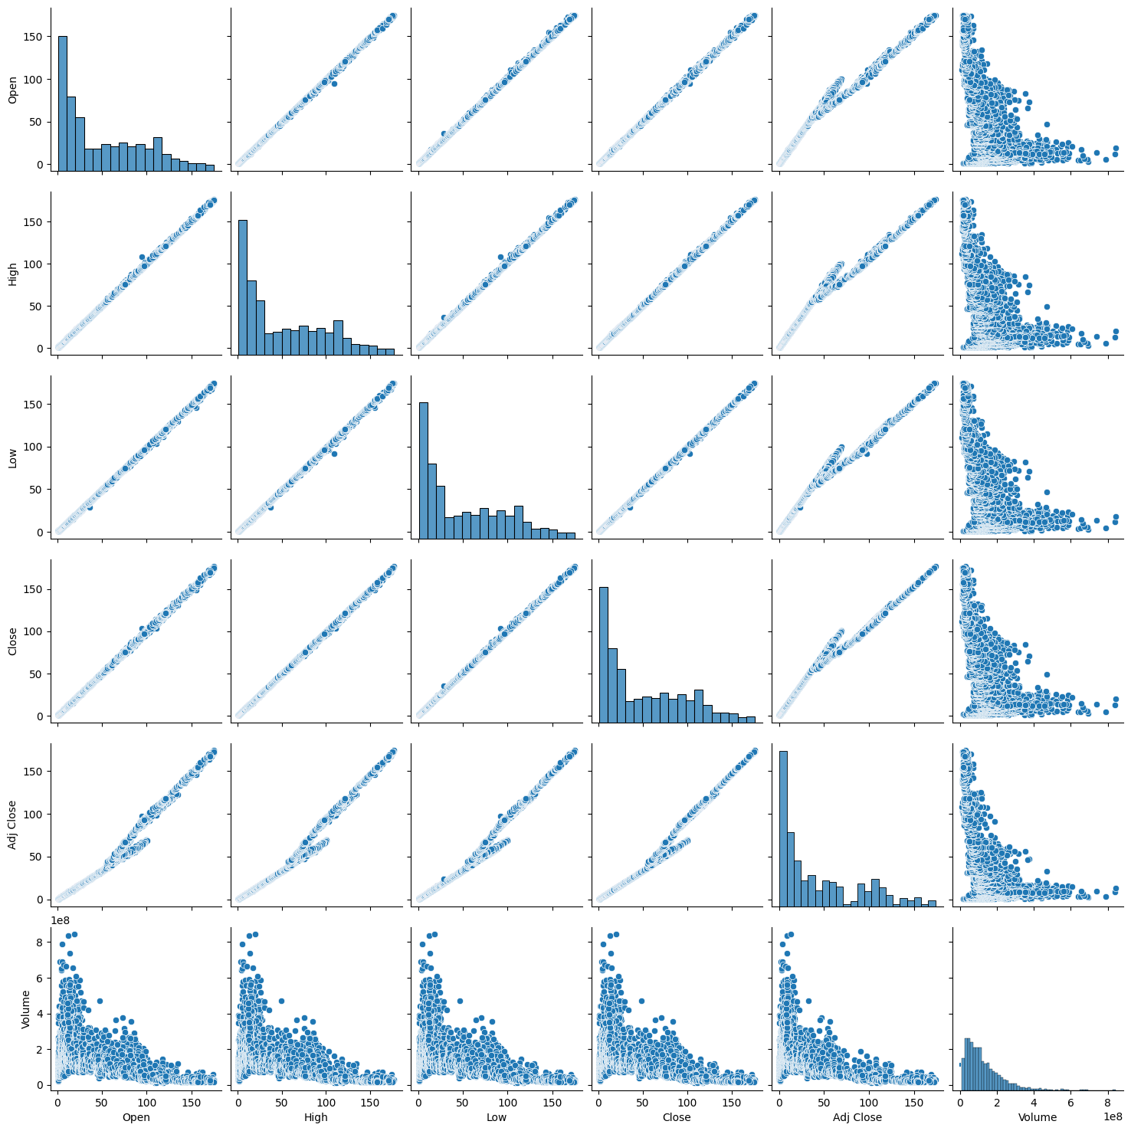
THE END USER
Investors and Traders:
They can utilize the predictions to make informed decisions about buying, selling, or holding Apple stocks.
Financial Analysts:
Professionals in finance can incorporate the predictions into their analyses and reports to provide insights to clients or stakeholders.
Researchers:
Those studying financial markets or machine learning applications in finance may find the project useful for further research or as a reference.
Algorithmic Trading Firms:
Companies engaged in algorithmic trading may integrate similar models into their trading strategies for automated decision-making.

Slide 7
SOLUTION AND VALUE PROPOSION
Building the LSTM Model:
A Sequential model is created using Keras.
Several LSTM layers with dropout regularization are stacked to capture temporal dependencies in the data.
The final layer is a Dense layer with a single unit, which predicts the next day's 'Open' price.
Model Compilation and Training:
The model is compiled with the Adam optimizer and Mean Squared Error (MSE) loss function.
The model is trained on the training data for 100 epochs with a batch size of 32.

Slide 8
MODEL
from keras.models import Sequential
from keras.layers import LSTM
from keras.layers import Dense
from keras.layers import Dropout
model=Sequential()
model.add(LSTM(units=60,return_sequences=True,input_shape=(X_train.shape[1],X_train.shape[2])))
model.add(Dropout(0.2))
model.add(LSTM(units=60,return_sequences=True))
model.add(Dropout(0.2))
model.add(LSTM(units=60,return_sequences=True))
model.add(Dropout(0.2))
model.add(LSTM(units=60,return_sequences=True))
model.add(Dropout(0.2))
model.add(LSTM(units=60,return_sequences=False))
model.add(Dropout(0.2))
model.add(Dense(units=1))
model.compile(optimizer='adam',loss='mean_squared_error')
model.fit(X_train,y_train,epochs=100,batch_size=32)

Slide 9
Making Predictions:
After training, the model is used to predict the 'Open' prices for the next 20 days (as specified in the test data).
The predicted prices are then inverse-transformed to the original scale using the MinMaxScaler.
Visualization:
The actual and predicted stock prices are plotted against time to visualize the model's performance.

Slide 10
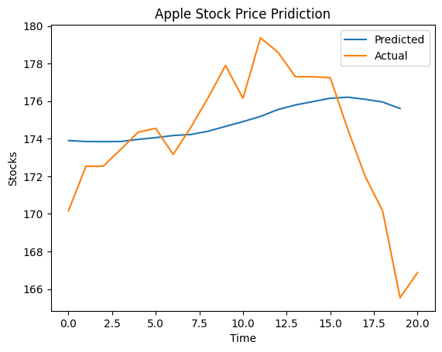
PREDICTION
predictions=model.predict(X_test)
trainPredict_extended = np.zeros((len(predictions),2))
trainPredict_extended[:,1] = predictions.transpose()
trainPredict_extended
VISUALISATION
trainPredict = Scaler.inverse_transform(trainPredict_extended)[:,1]
plt.plot(trainPredict,label='Predicted')
plt.plot(test_data,label='Actual')
plt.title('Apple Stock Price Pridiction')
plt.xlabel('Time')
plt.ylabel('Stocks')
plt.legend()

Slide 11
WOW OF THE SOLUTION
Advanced Technology:
This project utilizes LSTM cells, which are a type of Recurrent Neural Network (RNN), known for their ability to capture long-term dependencies in sequential data.
LSTM networks are particularly well-suited for time series prediction tasks like stock price forecasting.
Data Transformation:
This project demonstrates the importance of data preprocessing by applying min-max scaling to normalize the input data. This preprocessing step is essential for improving the convergence speed and performance of deep learning models.

Slide 12
Model Architecture:
The use of multiple LSTM layers with dropout regularization helps the model effectively capture complex patterns and temporal dependencies in the stock price data.
The sequential stacking of LSTM layers allows the model to learn hierarchical representations of the input sequences.
Prediction Accuracy:
Despite the inherent uncertainty and volatility of stock markets, the trained model is able to make accurate predictions of future stock prices.
The visualization of actual vs. predicted prices shows that the model captures the underlying trends and fluctuations in the data.
Real-world Application:
Stock price prediction has significant practical implications for investors, traders, and financial analysts.
The project demonstrates how deep learning techniques can be applied to real-world financial data to make informed decisions and potentially generate profits in the stock market.

Slide 13
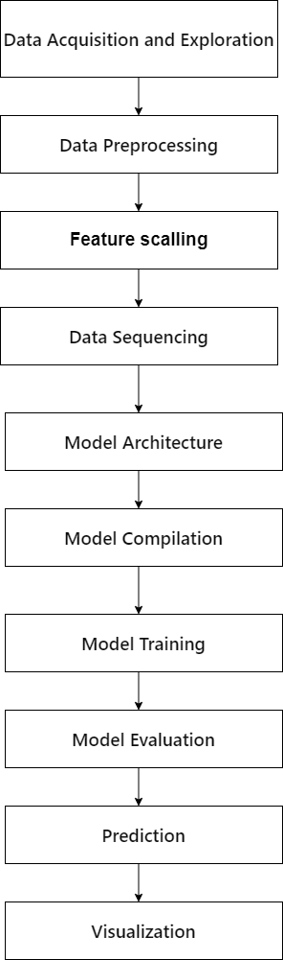
MODELLING

Slide 14
The implemented model is a Long Short-Term Memory (LSTM) neural network designed for stock price prediction.
It utilizes historical stock price data, particularly Open and Close prices, for training and testing.
The dataset is preprocessed by scaling the features and structuring them into sequences of 80 days, ensuring the LSTM model's input format.
The LSTM architecture consists of multiple layers with dropout regularization to prevent overfitting. The model is compiled using the Adam optimizer and mean squared error loss function. During training, the model undergoes 100 epochs with a batch size of 32.
After training, the model is evaluated on the test dataset and used to make predictions on future stock prices.
Finally, the model's performance is visualized by comparing its predictions with the actual stock prices over time.

Slide 15
RESULT
After training the model with historical stock price data, it is capable of making predictions on future stock prices.
These predictions are based on the patterns and trends learned from the input data during the training process.
The accuracy and effectiveness of the predictions can vary and depend on factors such as the quality of the data, the model architecture, and the chosen hyperparameters.

Slide 16
PREDICTED VALUES
array([[0. , 0.98128498], [0. , 0.98100567], [0. , 0.98096955], [0. , 0.98100436], [0. , 0.9816395 ], [0. , 0.98217309], [0. , 0.98281276], [0. , 0.98311043], [0. , 0.98408961], [0. , 0.98556888], [0. , 0.98700917], [0. , 0.98856699], [0. , 0.99065292], [0. , 0.99203682], [0. , 0.99304771], [0. , 0.99407315], [0. , 0.99438 ], [0. , 0.99375212], [0. , 0.9929291 ], [0. , 0.99097419]])

Slide 17
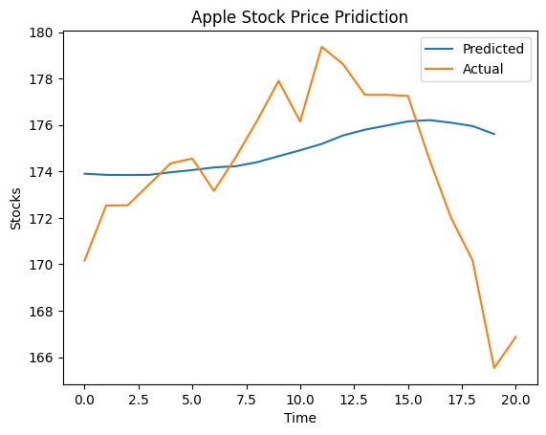
Additionally, the performance of the model can be evaluated by comparing its predictions with the actual stock prices using metrics such as mean squared error or visualizations.

Slide 18
CONCLUSION
The LSTM model demonstrates the ability to learn from historical stock price data and make predictions for future prices.
The accuracy and performance of the model can be further evaluated and improved by tuning hyperparameters, exploring different architectures, and incorporating additional features or data sources.
This program serves as a foundation for building more sophisticated stock price prediction models and can be extended for various financial forecasting tasks.

